Slide 1
Normalization
Design of database

Slide 2
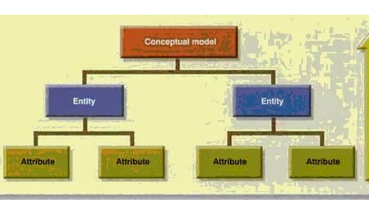
Database design methodologies
Top down Design
Bottom up Design
Notes:
The top-down method starts from the general and moves to the specific. Basically, you start with a general idea of what is needed for the system and then ask the end-users what data they need to store. The analyst will then work with the users to determine what data should be kept in the database. Using the top-down method requires that the analyst has a detailed understanding of the system. The top-down method also can have shortcomings. In some cases, top-down design can lead to unsatisfactory results because the analyst and end-users can miss something that is important and is necessary for the system.
The bottom-up approach begins with the specific details and moves up to the general. To begin a bottom-up design, the system analyst will inspect all the interfaces that the system has, checking reports, screens, and forms. The analyst will work backwards through the system to determine what data should be stored in the database.

Slide 3
Informal Design Guidelines for Relational Schemas
Making sure that the semantics of the attributes is clear in the schema
Reducing the NULL values in tuples
Reducing the redundant information in tuples
Eliminate anomalies in the schema

Slide 4
Problems with Null Values
Interpretations/ Reasons for nulls:
  Attribute not applicable or invalid
  Attribute value unknown
  Value known to exist, but unavailable
GUIDELINE:
  Relations should be designed such that their tuples will have as few NULL values as possible
  Attributes that are NULL frequently could be placed in separate relations (with the primary key)
  Example Employee with office phone numbers
Notes:
Manager of dept
Previous designation
An employee left : his permenant address/phone number

Slide 5
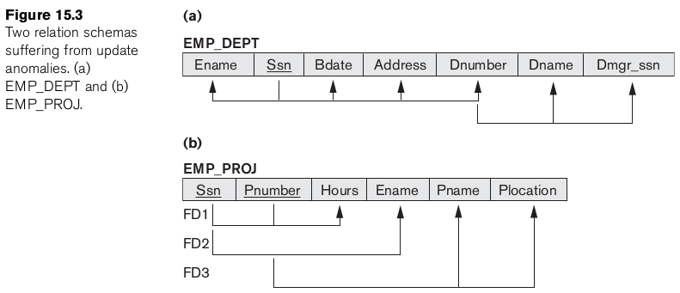
Why need normalization?
To analyze why one grouping is better than others.
To eliminate anomalies
To reduce redundancy
Notes:
Anomalies that cause redundant work to be done during insertion into and modification of a relation, and that may cause accidental loss of information during a deletion from a relation

Slide 6
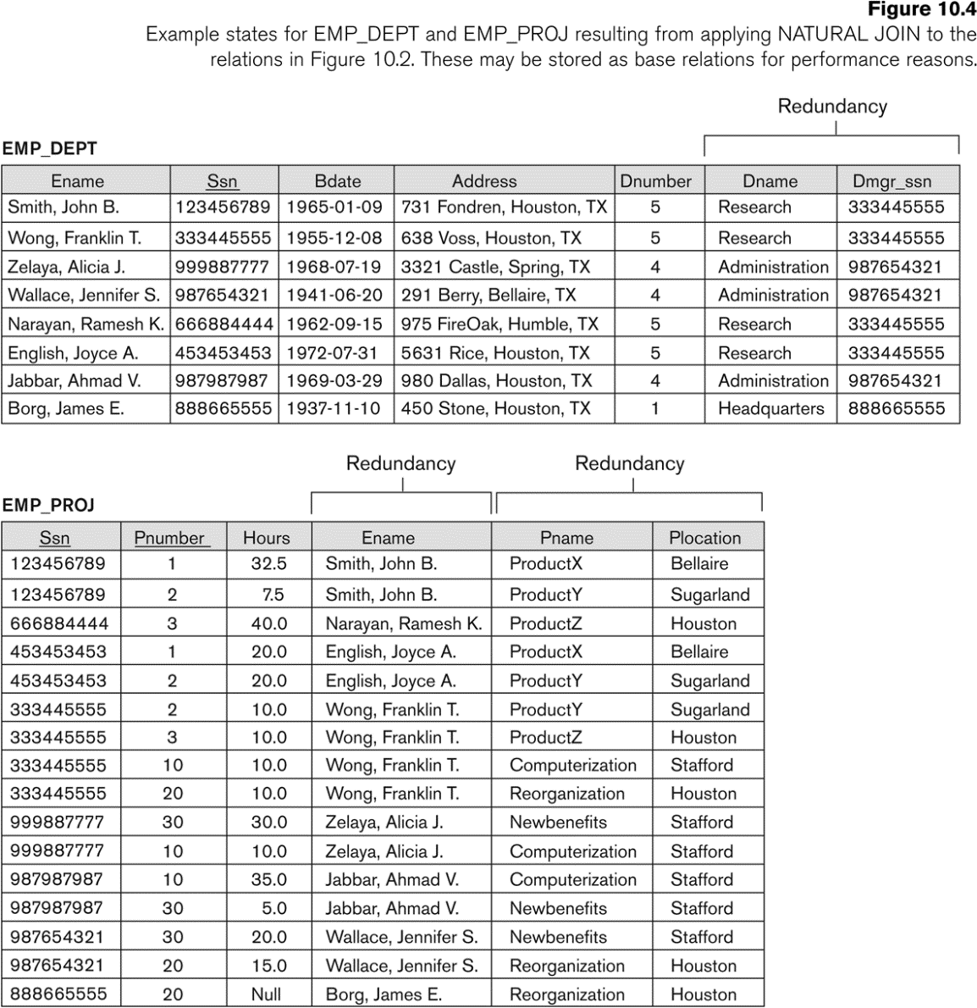

Slide 8
EXAMPLE OF AN INSERT ANOMALY
Consider the relation:
  EMP DEPT
  To enter an employee with dept 5 all attributes for dept 5 has to be entered again and again correctly. In the previous schema it was done once.
Insert Anomaly:
  Cannot insert a new department that has no employee as yet.
  In previous schema it was done.

Slide 9
EXAMPLE OF AN DELETE ANOMALY
Consider the relation:
  EMP DEPT
Delete Anomaly:
  If last employee of department is deleted department information is lost.
ALSO If department is deleted all employees of the department will get deleted.

Slide 10
EXAMPLE OF AN UPDATE ANOMALY
Consider the relation:
  EMP DEPT
Update Anomaly:
  Changing manager of department 5 will make us change for all employees working in department 5.
  THESE 3 ANOMALIES ARE UNDESIRED.

Slide 11
Normalization
To understand normalization we need to grasp a few concepts
  Functional dependency
  Axioms
  Closure
  Concept of Keys
    Super key
    Candidate Key
    Primary Key
    Secondary Key

Slide 12
1. Functional Dependency

Slide 13
A functional dependency is a relationship between two attributes in a database. In order for a functional dependency to exist, the value of one attribute must determine the value of another attribute. For example, if you have a database of employees, then the employee ID number would be a functional dependency of the employee’s name. This is because the employee ID number would determine which employee’s name is being referenced.

Slide 14
FD
A set of attributes X functionally determines a set of attributes Y if the value of X determines a unique value for Y
X -> Y holds if whenever two tuples have the same value for X, they must have the same value for Y
  For any two tuples t1 and t2 in any relation instance r(R): If t1[X]=t2[X], then t1[Y]=t2[Y]
X -> Y in R specifies a constraint on all relation instances r(R)

Slide 15
Example:
A -> B
if L.H.S i.e. X values are unique /non repeating
Then FD is valid
if L.H.S i.e. X value is not unique then check
for a particular x value is y value same ?
If Yes FD is valid
Otherwise FD is not valid
A | B
1 | 6
2 | 7
3 | 8
4 | 9
5 | 10

Slide 16
Example
Case I Case II
t₁ X -> Y t₁ So X -> Y
t₂ FD t₂ Not FD
X | Y
X₁ | Y₁
X₂ | Y₁
X | Y
X₁ | Y₁
X₁ | Y₂

Slide 17
Valid or invalid FD ?
A -> B Not True
A | B
1 | 6
2 | 7
3 | 8
2 | 9

Slide 18
FD Examples
CNIC -> Name
Name-> CNIC
Rollnumber → Name
Name → MobileNo
MobileNo → Name
DOB → CNIC
DOB → year of birth

Slide 19
FD
If K is a key of R, then K functionally determines all attributes in R
  (since we never have two distinct tuples with t1[K]=t2[K])

Slide 20
FD
Written as X -> Y; can be displayed graphically on a relation schema as in Figures. ( denoted by the arrow: )
FDs are derived from the real-world constraints on the attributes

Slide 21
Rules/Axioms
1) Composition | Decomposition of FDs.
X -> A; X -> B is equivalent to
X -> AB
i.e., let X be Empno
A be EmpFname
B be EmpLname
Empno -> EmpFname Empno -> EmpFname, EmpLname
Empno -> EmpLname

Slide 22
Identity: X -> X
Transitivity => X -> A, A -> B => X -> B
Augmentation if X -> A; Then X, Y -> A,Y
Decomposition: If X -> YZ, then X -> Y and X -> Z
Union: If X -> Y and X -> Z, then X -> YZ

Slide 23
Axiom Name | Axiom | Example
Reflexivity | if a is set of attributes, b ⊆ a, then a →b | SSN,Name → SSN
Augmentation | if a→ b holds and c is a set of attributes, then ca→cb | SSN → Name then SSN,Phone → Name, Phone
Transitivity | if a →b holds and b→c holds, then a→ c holds | SSN →Zip and Zip → City then SSN →City
Union or Additivity * | if a → b and a → c holds then a→ bc holds | SSN→Name and SSN→Zip then SSN→Name,Zip
Decomposition or Projectivity* | if a → bc holds then a → b and a → c holds | SSN→Name,Zip then SSN→Name and SSN→Zip
Pseudotransitivity* | if a → b and cb → d hold then ac → d holds | Address → Project and Project,Date →Amount thenAddress,Date → Amount
(NOTE) | ab→ c does NOT imply a → b and b → c

Slide 24
Attribute Closure
Definition : Set of attributes that are functionally determined by X
Example:
Find A⁺ , B⁺ ,C⁺, D⁺
R(ABCD)
FDs: { A -> B, B -> C, C -> D }

Slide 25
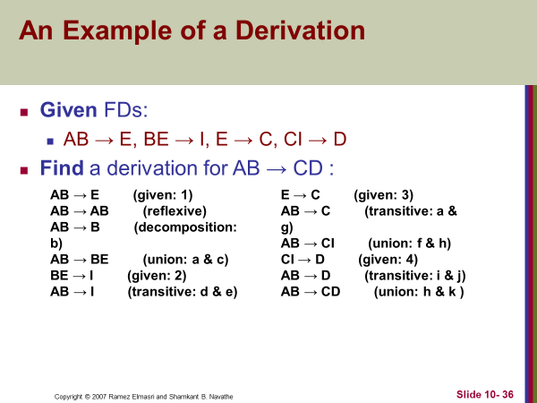

Slide 26
Closure
Given FDs:
  AB → E
  BE → I
  E → C
  CI → D
Question: Is B → CD in the closure?

Slide 27
Arbitrary Example of Closures:
AB -> CD , AF -> D , DE -> F , C -> G , F -> E, G -> A
(CF)⁺ =
(BG)⁺ =
(AF)⁺ =
(AB)⁺ =

Slide 28
Arbitrary Example of Closures:
AB -> CD AF -> D DE -> F C -> G F -> E, G -> A
(CF)⁺ = (CFGAED)
(BG)⁺ = (BGACD)
(AF)⁺ = AFDE
(AB)⁺ = ABCDG

Slide 29

Concept of Keys
Super Key
Candidate Keys
Primary Key
Secondary Key

Slide 30
Prime vs Non Prime Attributes
Prime Attributes are members of the candidate key which defines the uniqueness. (e.g. SSN in Employee database)
Super Key : Is a combination of attributes that uniquely determines a tuple.
A candidate key is a key that uniquely identifies the rows in the table. One can describe a candidate key as a super key that contains only the minimum number of columns necessary to determine uniqueness.
Any of the identified candidate keys can be used as the table’s primary key.
Candidate keys that are not of the primary key are called alternate keys/secondary keys.

Slide 31
Application of Attribute Closure:
If A⁺ contains all attributes of a relation then A is called Super Key. To find the minimal key from Super Key is known as Candidate Key.
Example 1:
(A,B,C,D,E)
{A->BC, CD->E, B->D, E->A}
Find which attribute closure consists of all the attributes?

Slide 32
Application of Attribute Closure:
If A⁺ contains all attributes of a relation then A is called Super Key. To find the minimal key from Super Key is known as Candidate Key.
Example 1:
(A,B,C,D,E)
{A->BC, CD->E, B->D, E->A}
A⁺ = ABCDE => Candidate Key
B⁺ = BD ✗ C⁺ = C ✗; D⁺ = ✗
E⁺ = EABCD => Candidate Key

Slide 33
Steps to determine Minimal Key
LEFT | MIDDLE | RIGHT
Attributes that appear only on left of FD | Attributes that appear both on left and right of FD | Attributes that appear only on right of FD
Draw above table and Fill in the values of left , Middle and Right looking at FD
Consider the left keys individually and then their combinations.
Then start combining one by one from middle to left

Slide 34
R(a,b,c,g,h,i) find the candidate keys?
A→b
B→h
A→c
Cg→h
Cg→i

Slide 35
Example 2:
R(A,B,C,D,E)
AB->C, CD->E, DE->B
Determine candidate keys.

Slide 36
Determine Candidate Keys
Example 1: R(ABCDE)
(FD) = { AB->C, C->D, D->E, A->B, C->A }

Slide 37
Determine Candidate Keys
Example 1: R(ABCDE)
(FD) = { AB->C, C->D, D->E, A->B, C->A }
Always check for leftside with more than one attribute if it exists:
(i) (AB)⁺ = ABCDE = R
(AB) is Super Key.
(ii) Now minimal key i.e.,
(A)⁺ = ABCDE = R i.e.,
(B) ⁺ = B
So, (AB)⁺ contains minimal C.K. = {A} Continued on next slide

Slide 38
(C)⁺ = CAB … R
So, C.K. = {A,C};
Prime Attribute = {A,C}
Non-Prime Attribute = {B,D,E}

Slide 39
Example 2: R(A,B,C,D,E)
FD = { A->D, AB->C, B->E, D->C, E->A }
Let (AB)⁺ = ABCED = R AB is Super Key
✗ (A)⁺ = ADC
(B)⁺ = BEA => R
C.K. = {B} Only
P.A. = {B} Only one.
N.P.A. = {C,D,A,E}

Slide 40
Example 3: R(A,B,C,D,E,F)
FD = { A->C, B->D, C->E, D->E, E->A, F->B }
(A)⁺ = ACE (C)⁺ = CEA (E)⁺ = EAC
(B)⁺ = BDEAC (D)⁺ = DEAC
(F)⁺ = FBDEAC = R =>
So,
C.K. = {F}
P.A. = {F}
N.P.A. = {A,B,C,D,E}

Slide 41
If any Attribute say “x” appears in R but is not part of FDs then “X” forms part of all KEYS.
R(ABCDEF)
FD = { AB->C, C->D, D->B, D->E, E->A }
(CF)⁺ = CDEABF = R
All attributes in R come in closure because of C except F

Slide 42
Example 4: R(ABCDE)
FD = { AB->C, C->D, D->B, D->E, E->A }
(A)⁺ = A
(B)⁺ = B
(C)⁺ = CDEAB = R
(D)⁺ = DBEA = R
(E)⁺ = EA
(AD)⁺ = ADEB = R
(AB)⁺ = ABCDE = R So, AB is S.K.
Left | Middle | Right
 | ABCDE

Slide 43
(AE)⁺ = AE
No Need to check BC, BD, CD, CE and DE because D and C are already CKs
(BE)⁺ = BEA = R
C.K. = {AB, BE, D, C}
P.A. = {A, B, E, D, C}
N.P.A. = { }

Slide 44
Partial and Full Functional dependency

Slide 45
Full Functional Dependency:
A & B are attributes of R, B is fully functionally dependent on A if B is functionally dependent on A but not on any proper subset of A. (or if removal of any attribute from A means that the dependency does not hold)
Example 1:
Staff(StaffNo, SName, position, Salary, BranchNo)
StaffNo, SName -> BranchNo
It is not fully functional dependent because BranchNo is functionally dependent on a subset of {StaffNo, Sname} i.e., StaffNo -> BranchNo

Slide 46
Example 2:
{SSN, age} -> name is not fully functional dependent, it is not functional dependent because we can remove {age} from left side of the statement w/o impacting the dependency relationship.

Slide 47
Normal Forms
First Normal form 1NF
Second normal form 2NF
Third normal form 3NF
Boyce Codd Normal Form BCNF
Fourth normal form 4NF
Fifth normal form 5NF

Slide 48
First Normal Form
This normal form disallows
  Multivalued attribute
  Composite attribute
  A relation R is said to be in 1NF if it has no composite or multivalued attribute and has a primary key.

Slide 49
Example
Given
R(a,b,c,d)
Provided that it has no multivalued or composite attribute. State in which normal form R is?

Slide 50
Example
Given
R(a,b,c,d)
Provided that a is multivalued and c is the primary key. Which normal form this relation is in?
How to solve multivalued attribute problem ?
R is broken into two relations
R1(c,b,d)
R2(a,c)
Why c is also added in R2?

Slide 51
Second Normal Form
This states:
  Relation should be in 1NF
  In a relation which has a composite key there should be no partial dependency on the primary key.

Slide 52
Second Normal Form
Solution: Make separate tables for all the partial functional dependencies. Separate table for full functional dependencies.

Slide 53
Second Normal Form
R1(SSN, PNO,Hours)
R2(SSN, Ename)
R3(Pno, Pname , Plocation)

Slide 54
Third Normal Form
This states that the R should be in 2NF
There should be no transitive dependency on the primary key.
Transitivity :
A→B
B→C
Now check if a is Primary key and B is not candidate key
Then there is a problem and 3nf needs to be applied. Other wise we say that R has already satisfied 3NF.

Slide 55
How to apply 3NF
Move transitivity to separate table.

Slide 56
How to apply 3NF
R1( SSN, Ename,Bdate,Address, Dno)
R2( Dno, Dname, DmgrSSN)

